Slide 1
Machine Learning
Getting better all the time

Slide 2
What Is Learning
Improving performance over time
Adapting to changing circumstances
Acquiring new knowledge
In AI, approximating a mapping function
Given some set of inputs
And a corresponding set of outputs
Approximate a function which will map the given inputs to the given outputs
Often defined as a search problem
Searching a problem space

Slide 3
How To Learn
Need an evaluation function
Tells us how ‘good’ our performance is
Need a set of training data
Need a set of test data
Initial state of system usually random
Learning progresses over multiple iterations
Until convergence (no more improvement possible)
Or some measure of performance is deemed satisfactory
Convergence describes the state when no more learning is possible
Common to accept performance which is good enough
Problem has been learned

Slide 4
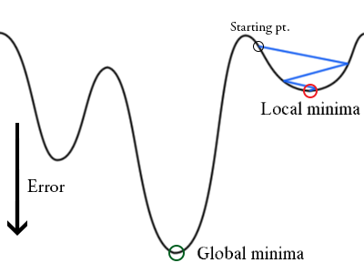
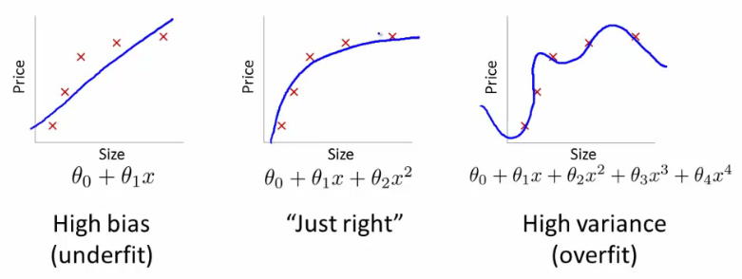
Training Problems
Failing to converge
Data set may not be adequate
Not enough data
Data has insufficient examples
Local minima
System can get stuck in a non optimal solution
Slight randomisation in early training can help
Overfitting
System has failed to generalise
Improve training data
Underfitting
System over-generalises
Improve training data
Try new algorithm
Local minima

Slide 5
Types Of Learning
Supervised learning
Solution is shown to learner, learner practices until improvement evident
Unsupervised learning
Learner attempts candidate solutions, measures performance, tries to improve performance
Reinforcement learning
Rewarding success, punishing failure
Gradient descent
Minimising an error value
Or hill climbing, maximising a fitness function
Induction
Supervised learning
Learning generalised classifications from specific examples
Offline
Learning occurs during development time, behaviour fixed at runtime
Online
Learning occurs during operation of the system

Slide 6
Algorithm Zoo
Many different algorithms for machine learning
An opportunity for some personal research
Different strengths and weaknesses
Understand problem
Know the algorithms
Make the right choice
We will look at three specifically
Q-Learning
Decision Tree learning
Neural Networks

Slide 7
Machine Learning In Games
Board games have long history of machine learning
Arthur Samuel checkers playing program – Damen 1960
Latest is Google’s AlphaGo, you might have heard of it
Less application to other game genres
But some exist
Black & White (decision tree learning)
Forza Motorsport (neural network)
Creatures (neural network, genetic algorithms)

Slide 8
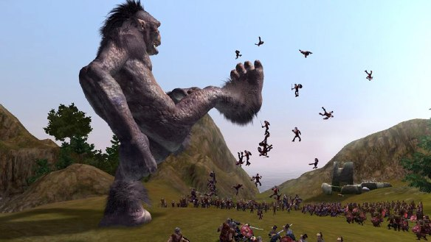
Black & White

Slide 9
Training Your Creature
Gameplay revolves around training creature
Positive reinforcement
Rewards actions to be encouraged
Tends to make repeat of action more likely
Punishment
Negative reinforcement
Makes repeat of action less likely
System must track which action triggered player reaction
This information used to build decision tree

Slide 10
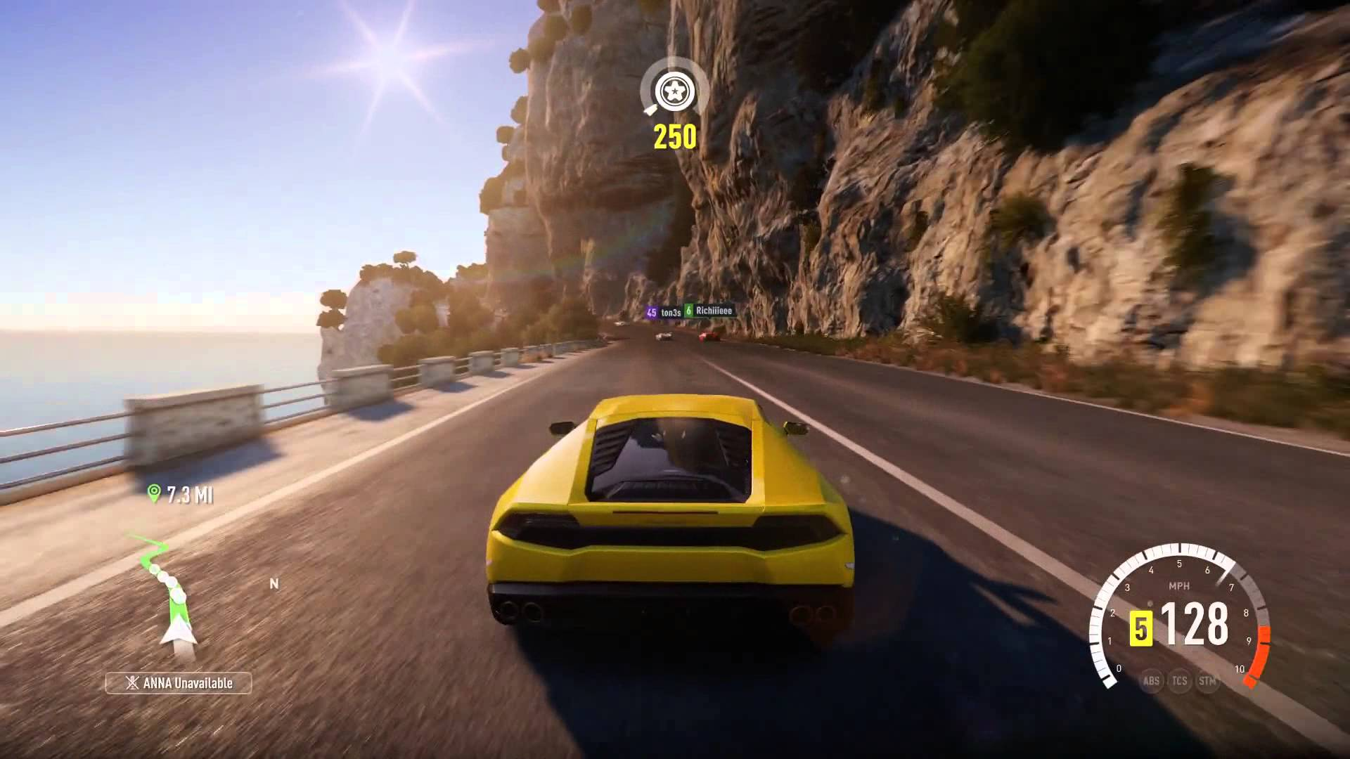
Forza Horizon 2 (Drivatar)

Slide 11
Learning To Drive
Forza Horizon 2 uses neural network to learn player drive style
Called Drivatar technology
Player can train Drivatar’s to race against
Drives like player
Example of online learning, neural network learns during gameplay

Slide 12
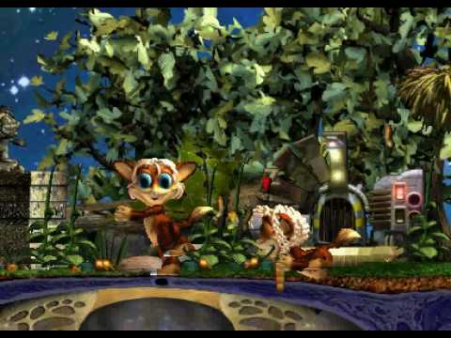
Creatures

Slide 13
How To Look After Your Creature
Used genetic algorithms and neural networks
Genetic algorithms used to make each generation different
Hopefully better
Neural networks allow player to train creature
Slap to punish : negative reinforcement
Tickle to reward : positive reinforcement
Creatures had to learn everything
To eat, to play etc.
If not trained, quickly die
Player must keep creatures alive

Slide 14
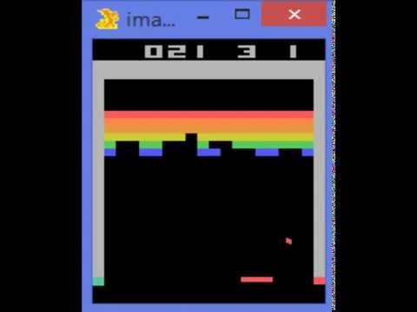
Google DeepMind's Deep Q-learning Playing Atari Breakout

Slide 15
Advantages Of Learning
AI is less predictable
Gives better replayability as AI different every time
AI can scale with player
Can provide original gaming experience

Slide 16
Problems Of Machine Learning In Games
System needs measure of performance
E.g. damage done, distance moved, opponent pieces taken
When can useful feedback be given?
Credit assignment problem
May have taken many moves to reach winning state
How to allocate reward to good moves in early stages of play
Predictability
Learning system may not learn what you expect it to
US Army’s sunny day detector
Representation
Choice of representation of problem has significant effect on performance
Wrong representation can result in failure to learn
Very hard to debug

Slide 17
The Future
As machine learning techniques improve
Will be used more often
However, board games still predominate
Open worlds very complex
Hard to find representations
Many possible alternatives
Increasing processor power a significant factor
Machine learning often processor intensive

